Slide 1
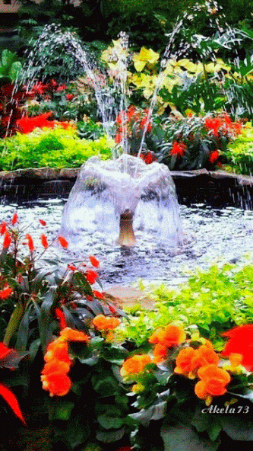
Welcome to Digital Class

Slide 2
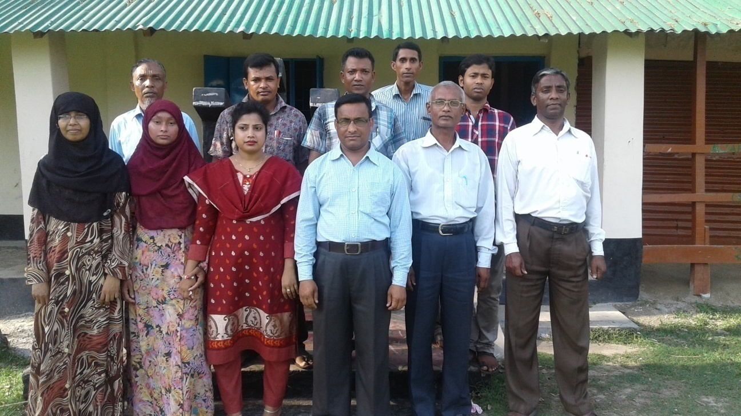
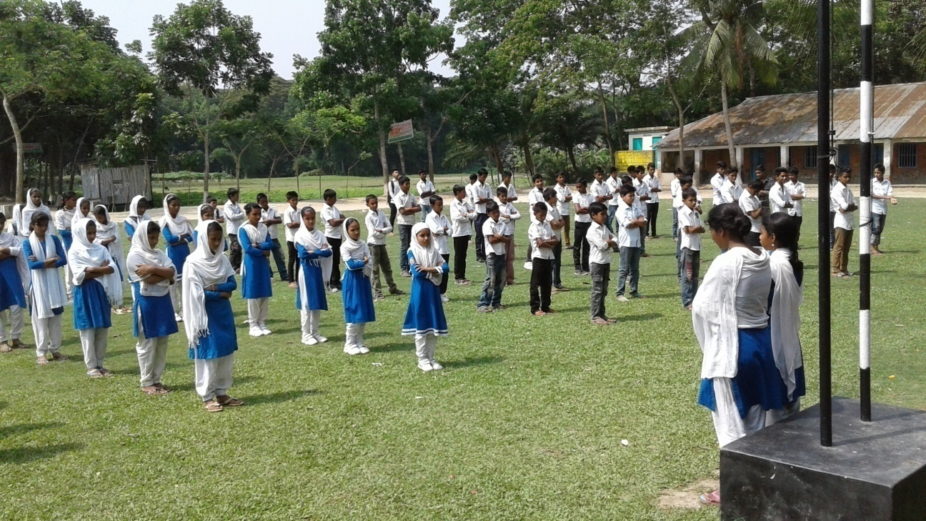
School Identity

Slide 3

Teacher Identity
Shanti RanjanChakraborty
Assistant Teacher
Shanuher M A High School
Ujirpur, Barisal.
Mobile-01715485221
Email-shanti02266@gmail.com

Slide 4
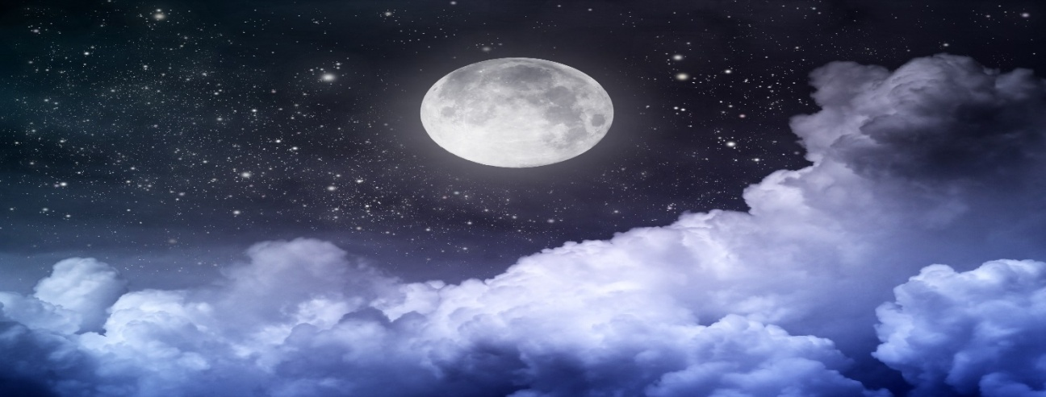
What is the picture

Slide 5
Think about the pictures
It is A Moonlit Night

Slide 6
Our Todays lesson is on-Paragraph-
A Moonlit Night.
Writing Part of English 1st Paper

Slide 7
What is a moonlit night?
A moonlit night is a night in which the full noon shines in its entire glory in the sky is called a moonlit night. Itis one of the beautiful object of nature.

Slide 8
When does it occur?
It occurs when the moon rises in the sky. It is very romantic to both male and female.

Slide 9

How does the moon look?
The moon looks like a big silver disc in the sky. The moon may be crescent or full, but it is beautiful in both forms.

Slide 10
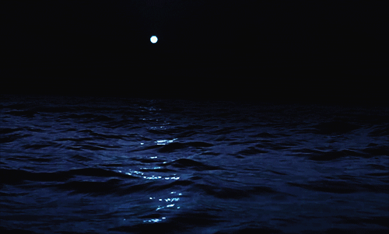

When does the sky remain clear?
In Autumn the sky remains quite clear. So, the silvery light over floods everything.

Slide 11
When does the moon do?
The moon plays hide-and-seek with these bulging pieces of clouds. It is very pleasant to look at.

Slide 12
What create a musical spell?
The smooth moon’s rays reflecting on seas, rivers, ponds and hills create a music spell. It please our eyes and mind.

Slide 13
The natural beauty of a moonlit night can better be realized than described. People feel great joy.

Slide 14
What do the children do?
Little children sit round their grandmamma to hear the fairy tales or the tales about the wizards. Sometimes they play hide and seek together and have fun themselves.

Slide 15
To whom is it very romantic?
A moon light nigh is very romantic to the newly married couple and who are in love. The poet of all language praised highly.

Slide 16
Women sit in the yard and gossip or they can make their babies sleep singing the songs of stars and moon.
What do men and women do?

Slide 17
What do the lower animal do on a moonlit night?
Lower animals take the moonlit for day and start roaming about.

Slide 18
A moonlit night is nature's sweetest offer to mankind. It has a lasting effect the human minds. Even the grand old ladies remember their green youth when they sit alone in the moonlit night.

Slide 19
Group Work

Slide 20
Evaluation
Answer the following questions:
What is a moonlit night?
What do men and women do in a moonlit night?
What do the children do?
What is the main attraction of a moon lit night?
What looks like a silver disk?

Slide 21
Home Work
Write a paragraph on
“A Moonlit night”

Slide 22
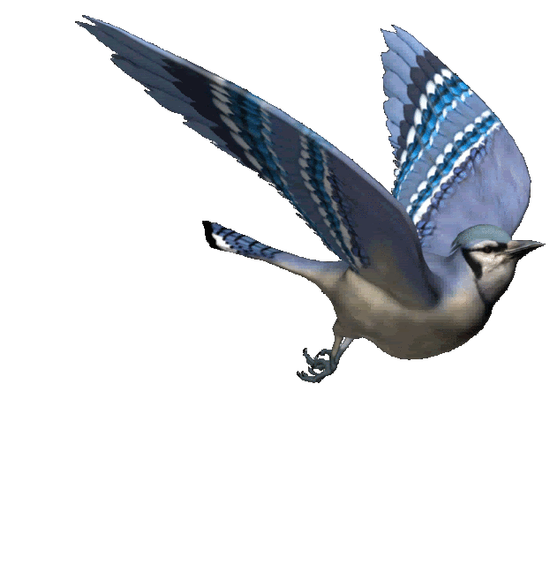
Thank you all

Slide 23
After completing this lesson the learners will be able to-
listen information
ask and answer questions
write a paragraph.

Slide 24
A Moonlit Night
A moonlit night in which the full moon shines in its entire glory in the sky is called a moonlit night. It is one of the beautiful object of nature and a night of dream and enjoyment. It occurs when the moon rises in the sky. It is very romantic to both male and female. The moon may be crescent or full, but it is beautiful in both forms. The natural beauty of a moonlit night can better be realized than described. In Autumn the moon appears in its best as the sky remains quite clear. The silvery light over floods everything. The moon looks like a big silver disc in the sky. The moon’s rays reflecting on seas, rivers, ponds and hills create a music spell. The smooth rays of the moon please our eyes and mind. The moon plays hide-and-seek with the bulging pieces of clouds. It is very pleasant to look at. People feel great joy. Little children sit round their grandmamma to hear the fairy tales or the tales about the wizards. Sometimes they play hide and seek together and have fun themselves. A moon light night is very romantic to the newly married couple and who are in love. The poet of all language praised highly. Women sit in the yard and gossip or they can make their babies sleep singing the songs of stars and moon. Lower animals take the moonlit for day and start roaming about. A moonlit night is nature's sweetest offer to mankind. It has a lasting effect the human minds. Even the grand old ladies remember their green youth when they sit alone in the moonlit night.

